Slide 1
Overview
Why to study computer organization and architecture?
Design better programs, including system software such as compilers, operating systems, and device drivers.
  Optimize program behavior.
  Evaluate (benchmark) computer system performance.
  Understand time, space, and price tradeoffs.

Slide 2
Overview
Computer organization
  physical aspects of computer systems.
  E.g., circuit design, control signals, memory types.
  How does a computer work?
Computer architecture
  Logical aspects of system as seen by the programmer.
  E.g., instruction sets, instruction formats, data types, addressing modes.
  How do I design a computer?

Slide 3
Computer Components
At the most basic level, a computer is a device consisting of three pieces:
  A processor to interpret and execute programs
  A memory to store both data and programs
  A mechanism for transferring data to and from the outside world.

Slide 4
Computer Components
At the most basic level, a computer is a device consisting of three pieces:
  A processor to interpret and execute programs
  A memory to store both data and programs
  A mechanism for transferring data to and from the outside world.

Slide 5
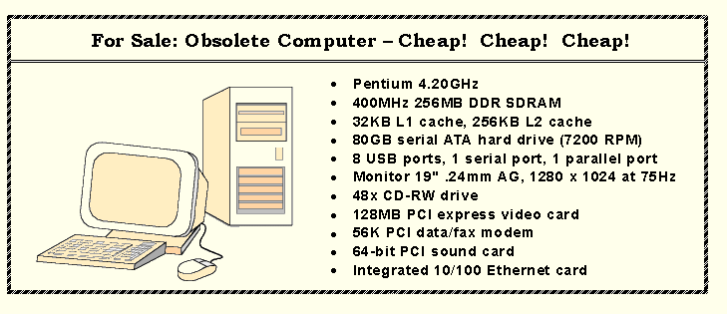
An Example System
Consider this advertisement:
MHz??
L1 Cache??
MB??
PCI??
USB??
What does it all mean??

Slide 6
An Example System
Measures of capacity and speed:
  Kilo- (K) = 1 thousand = 10³ and 2¹⁰
  Mega- (M) = 1 million = 10⁶ and 2²⁰
  Giga- (G) = 1 billion = 10⁹ and 2³⁰
  Tera- (T) = 1 trillion = 10¹² and 2⁴⁰
  Peta- (P) = 1 quadrillion = 10¹⁵ and 2⁵⁰

Slide 7
An Example System
Hertz = clock cycles per second (frequency)
  1MHz = 1,000,000Hz
  Processor speeds are measured in MHz or GHz.
Byte = a unit of storage
  1KB = 2¹⁰ = 1024 Bytes
  1MB = 2²⁰ = 1,048,576 Bytes
  Main memory (RAM) is measured in MB
  Disk storage is measured in GB for small systems, TB for large systems.

Slide 8
An Example System
Measures of time and space:
  Milli- (m) = 1 thousandth = 10 ⁻³
  Micro- (μ) = 1 millionth = 10 ⁻⁶
  Nano- (n) = 1 billionth = 10 ⁻⁹
  Pico- (p) = 1 trillionth = 10 ⁻¹²
  Femto- (f) = 1 quadrillionth = 10 ⁻¹⁵

Slide 9
An Example System
Millisecond = 1 thousandth of a second
  Hard disk drive access times are often 10 to 20 milliseconds.
Nanosecond = 1 billionth of a second
  Main memory access times are often 50 to 70 nanoseconds.
Micron (micrometer) = 1 millionth of a meter
  Circuits on computer chips are measured in microns.

Slide 10
An Example System
Cycle time is the reciprocal of clock frequency.
A bus operating at 133MHz has a cycle time of 7.52 nanoseconds:
133,000,000 cycles/second = 7.52ns/cycle
Now back to the advertisement ...

Slide 11
An Example System
The microprocessor is the “brain” of the system. It executes program instructions. This one is a Pentium (Intel) running at 4.20GHz.
A system bus moves data within the computer. The faster the bus the better. This one runs at 400MHz.

Slide 12
An Example System
Large main memory capacity means you can run larger programs with greater speed than computers having small memories.
RAM = random access memory. Time to access contents is independent of its location.
Cache is a type of temporary memory that can be accessed faster than RAM.

Slide 13
An Example System
This system has 256MB of (fast) synchronous dynamic RAM (SDRAM) . . .
… and two levels of cache memory, the level 1 (L1) cache is smaller and (probably) faster than the L2 cache. Note that these cache sizes are measured in KB.

Slide 14
An Example System
This system has 256MB of (fast) synchronous dynamic RAM (SDRAM) . . .
… and two levels of cache memory, the level 1 (L1) cache is smaller and (probably) faster than the L2 cache. Note that these cache sizes are measured in KB.

Slide 15
An Example System
Hard disk capacity determines the amount of data and size of programs you can store.
This one can store 80GB. 7200 RPM is the rotational speed of the disk. Generally, the faster a disk rotates, the faster it can deliver data to RAM. (There are many other factors involved.)

Slide 16
An Example System
ATA stands for advanced technology attachment, which describes how the hard disk interfaces with (or connects to) other system components.
A CD can store about 650MB of data. This drive supports rewritable CDs, CD-RW, that can be written to many times.. 48x describes its speed.

Slide 17
An Example System
Ports allow movement of data between a system and its external devices.
This system has ten ports.

Slide 18
An Example System
Serial ports send data as a series of pulses along one or two data lines.
Parallel ports send data as a single pulse along at least eight data lines.
USB, Universal Serial Bus, is an intelligent serial interface that is self-configuring. (It supports “plug and play.”)

Slide 19
An Example System
System buses can be augmented by dedicated I/O buses. PCI, peripheral component interface, is one such bus.
This system has three PCI devices: a video card, a sound card, and a data/fax modem.

Slide 20
An Example System
The number of times per second that the image on a monitor is repainted is its refresh rate. The dot pitch of a monitor tells us how clear the image is.
This one has a dot pitch of 0.24mm and a refresh rate of 75Hz.
The video card contains memory and programs that support the monitor.

Slide 21
Historical Development
The evolution of computing machinery has taken place over several centuries.
The evolution of computers is usually classified into different generations according to the technology of the era.

Slide 22
Historical Development
Generation Zero: Mechanical Calculating Machines (1642 - 1945)
  Calculating Clock - Wilhelm Schickard (1592 - 1635).
  Pascaline - Blaise Pascal (1623 - 1662).
  Difference Engine - Charles Babbage (1791 - 1871), also designed but never built the Analytical Engine.
  Punched card tabulating machines - Herman Hollerith (1860 - 1929).
Hollerith cards were commonly used for computer input well into the 1970s.

Slide 23
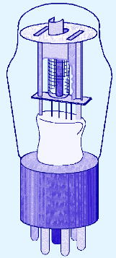
Historical Development
The First Generation: Vacuum Tube Computers (1945 - 1953)
  Atanasoff Berry Computer (1937 - 1938) solved systems of linear equations.
  John Atanasoff and Clifford Berry of Iowa State University.

Slide 24
Historical Development
The First Generation: Vacuum Tube Computers (1945 - 1953)
  Electronic Numerical Integrator and Computer (ENIAC) by John Mauchly and J. Presper Eckertat the University of Pennsylvania, 1946
  The IBM 650 first mass-produced computer. (1955). It was phased out in 1969.

Slide 25
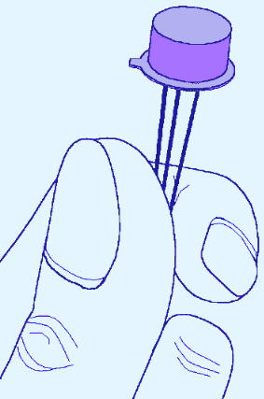
Historical Development
The Second Generation: Transistorized Computers (1954 - 1965)
  IBM 7094 (scientific) and 1401 (business)
  Digital Equipment Corporation (DEC) PDP-1
  Univac 1100
  Control Data Corporation 1604.
  . . . and many others.

Slide 26
Historical Development
The Third Generation: Integrated Circuit Computers (1965 - 1980)
  IBM 360
  DEC PDP-8 and PDP-11
  Cray-1 supercomputer
  . . . and many others.
By this time, IBM had gained overwhelming dominance in the industry.
  Computer manufacturers of this era were characterized as IBM and the BUNCH (Burroughs, Unisys, NCR, Control Data, and Honeywell).

Slide 27
Historical Development
The Fourth Generation: VLSI Computers (1980 - ????)
  Very large scale integrated circuits (VLSI) have more than 10,000 components per chip.
  Enabled the creation of microprocessors.
  The first was the 4-bit Intel 4004.
  Later versions, such as the 8080, 8086, and 8088 spawned the idea of “personal computing.”

Slide 28
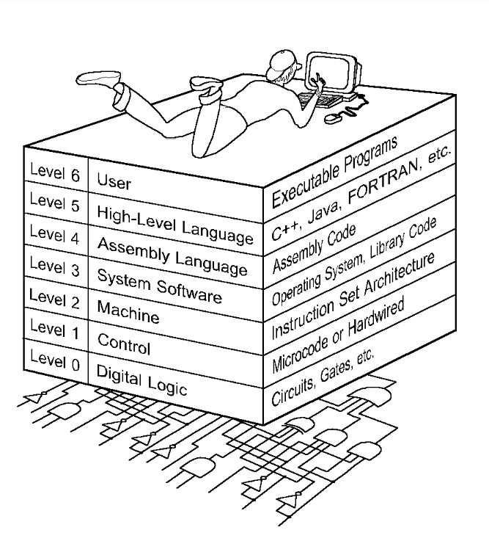
The Computer Level Hierarchy
Each virtual machine layer is an abstraction of the level below it.
The machines at each level execute their own particular instructions, calling upon machines at lower levels to perform tasks as required.
Computer circuits ultimately carry out the work.

Slide 29
The Computer Level Hierarchy
Level 6: The User Level
  Program execution and user interface level.
  The level with which we are most familiar.
Level 5: High-Level Language Level
  The level with which we interact when we write programs in languages such as C, Pascal, Lisp, and Java.

Slide 30
The Computer Level Hierarchy
Level 4: Assembly Language Level
  Acts upon assembly language produced from Level 5, as well as instructions programmed directly at this level.
Level 3: System Software Level
  Controls executing processes on the system.
  Protects system resources.
  Assembly language instructions often pass through Level 3 without modification.

Slide 31
The Computer Level Hierarchy
Level 2: Machine Level
  Also known as the Instruction Set Architecture (ISA) Level.
  Consists of instructions that are particular to the architecture of the machine.
  Programs written in machine language need no compilers, interpreters, or assemblers.

Slide 32
The Computer Level Hierarchy
Level 1: Control Level
  A control unit decodes and executes instructions and moves data through the system.
  Control units can be microprogrammed or hardwired.
  A microprogram is a program written in a low-level language that is implemented by the hardware.
  Hardwired control units consist of hardware that directly executes machine instructions.

Slide 33
The Computer Level Hierarchy
Level 0: Digital Logic Level
  This level is where we find digital circuits (the chips).
  Digital circuits consist of gates and wires.
  These components implement the mathematical logic of all other levels.

Slide 34
The von Neumann Model
On the ENIAC, all programming was done at the digital logic level. Programming the computer involved moving plugs and wires.
A different hardware configuration was needed to solve every unique problem type.
Configuring the ENIAC to solve a “simple” problem required many days labor by skilled technicians.

Slide 35
The von Neumann Model
The invention of stored program computers has been ascribed to a mathematician, John von Neumann, who was a contemporary of Mauchley and Eckert.
Stored-program computers have become known as von Neumann Architecture systems.

Slide 36
The von Neumann Model
Today’s stored-program computers have the following characteristics:
  Three hardware systems:
    A central processing unit (CPU)
    A main memory system
    An I/O system
  The capacity to carry out sequential instruction processing.
  A single data path between the CPU and main memory.
    This single path is known as the von Neumann bottleneck.

Slide 37
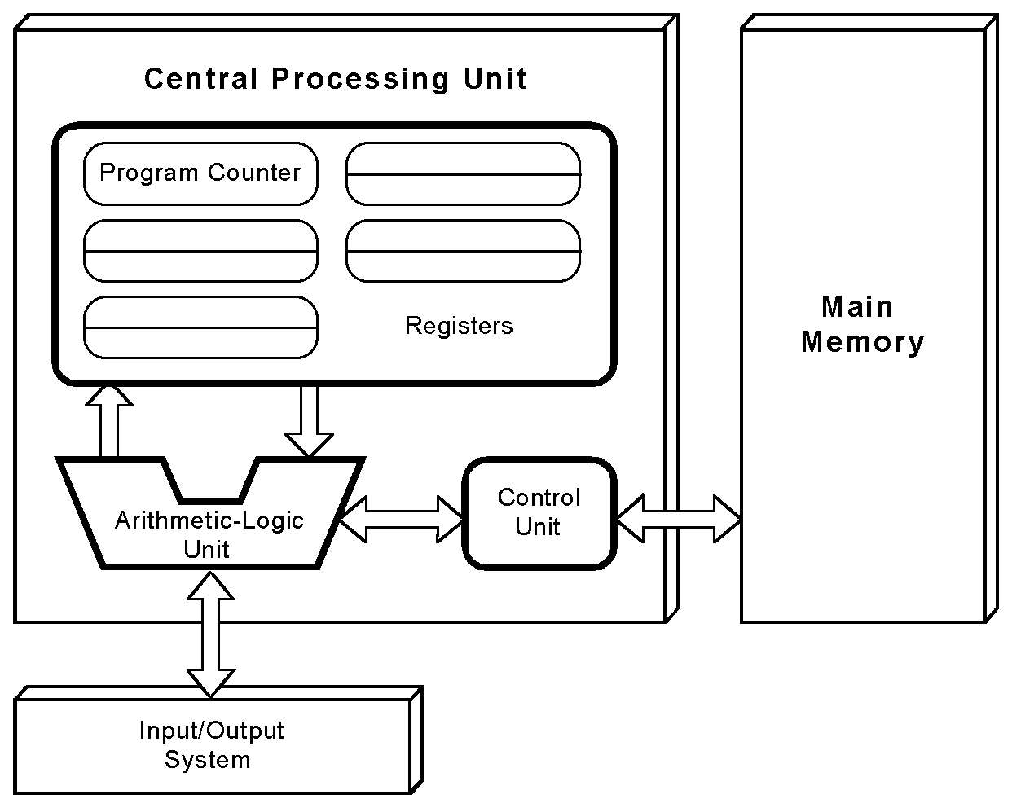
The von Neumann Model
This is a general depiction of a von Neumann system:
These computers employ a fetch-decode-execute cycle to run programs as follows . . .

Slide 38
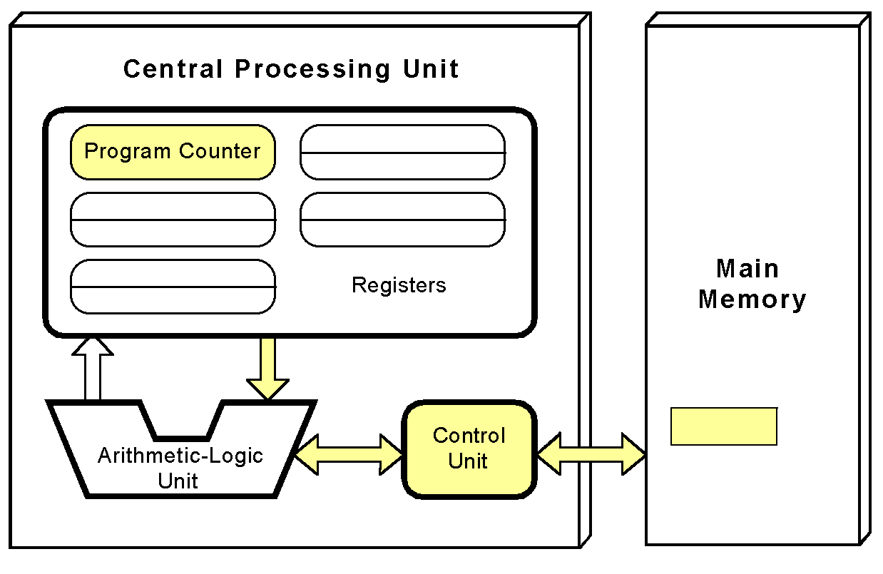
The von Neumann Model
The control unit fetches the next instruction from memory using the program counter to determine where the instruction is located.

Slide 39
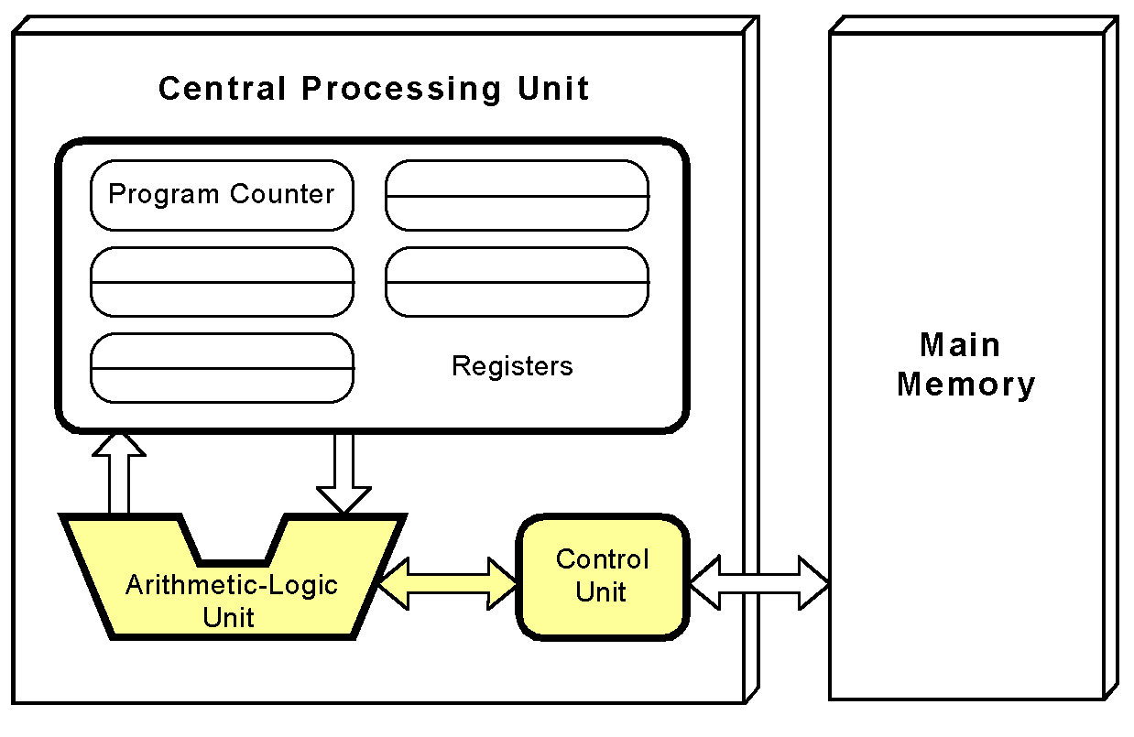
The von Neumann Model
The instruction is decoded into a language that the ALU can understand.

Slide 40
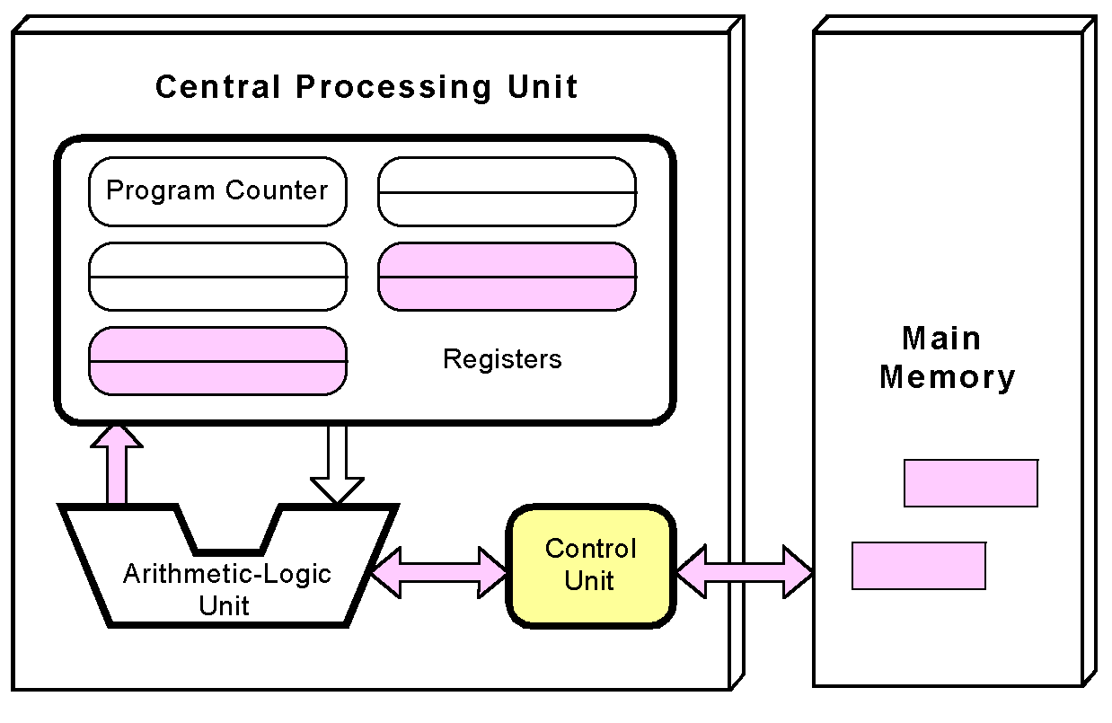
The von Neumann Model
Any data operands required to execute the instruction are fetched from memory and placed into registers within the CPU.

Slide 41
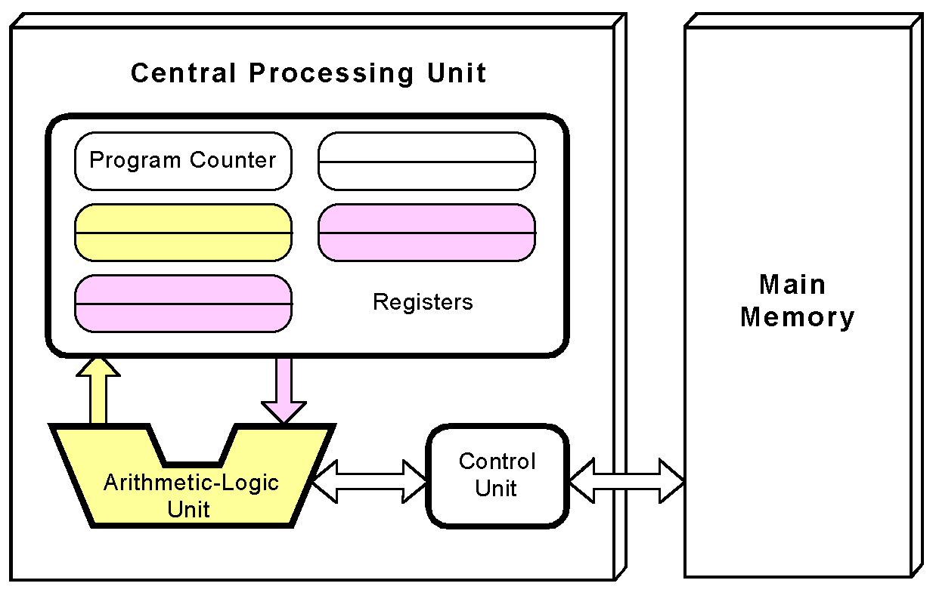
The von Neumann Model
The ALU executes the instruction and places results in registers or memory.

Slide 42
Non-von Neumann Models
Conventional stored-program computers have undergone many incremental improvements over the years.
These improvements include adding specialized buses, floating-point units, and cache memories, to name only a few.
But enormous improvements in computational power require departure from the classic von Neumann architecture.
Adding processors is one approach.

Slide 43
Non-von Neumann Models
In the late 1960s, high-performance computer systems were equipped with dual processors to increase computational throughput.
In the 1970s supercomputer systems were introduced with 32 processors.
Supercomputers with 1,000 processors were built in the 1980s.
In 1999, IBM announced its Blue Gene system containing over 1 million processors.

Slide 44
Non-von Neumann Models
Parallel processing is only one method of providing increased computational power.
DNA computers, quantum computers, and dataflow systems. At this point, it is unclear whether any of these systems will provide the basis for the next generation of computers.

Slide 45
Non-von Neumann Models
Leonard Adleman is often called the inventor of DNA computers. His article in a 1994 issue of the journal Science outlined how to use DNA to solve a well-known mathematical problem, called the "traveling salesman" problem. The goal of the problem is to find the shortest route between a number of cities, going through each city only once. As you add more cities to the problem, the problem becomes more difficult. Adleman chose to find the shortest route between seven cities. DNA computing is still in its infancy.

